Slide 1

Picking

Slide 2
Picking
Refers to the operation of Selecting objects from the display. i.e., Identifying a user-defined object on the display.
We use a pick device to select a part of a scene that is to be transformed or edited in some way. Several different methods can be used to select a component of a displayed scene, and any input mechanism used for this purpose is classified as a pick device.
Most often, pick operations are performed by positioning the screen cursor. Using a mouse, joystick, or keyboard, for example, we can perform picking by positioning the screen cursor and pressing a button or key to record the pixel coordinates. This screen position can then be used to select an entire object, a facet of a tessellated surface, a polygon edge, or a vertex.
Other pick methods include highlighting schemes, selecting objects by name, or a combination of methods.

Slide 3
Rendering Modes:
OpenGL can render in one of three modes selected by glRenderMode(mode)
GL_RENDER: normal rendering to the frame buffer (default)
GL_FEEDBACK: provides list of primitives rendered but no output to the frame buffer
GL_SELECT: Each primitive in the view volume generates a hit record that is placed in a name stack which can be examined later
Selection Mode Functions:
glSelectBuffer(): specifies name buffer
glInitNames(): initializes name buffer
glPushName(id): push id on name buffer
glPopName(): pop top of name buffer
glLoadName(id): replace top name on buffer, id is set by application program to identify objects

Slide 4
Using Selction Mode:
Initialize name buffer
Enter selection mode (using mouse)
Render scene with user-defined identifiers
Reenter normal render mode. This operation returns number of hits
Examine contents of name buffer (hit records). Hit records include id and depth information

Slide 5
A pick window within a selected viewport is defined using the following GLU function:
gluPickMatrix (xPick, yPick, widthPick, heightPick, vpArray);
Parameters xPick and yPick give the double-precision, screen-coordinate location for the center of the pick window relative to the lower-left corner of the viewport.
When these coordinates are given with mouse input, the mouse coordinates are relative to the upper-left corner, and thus we need to invert the input yMouse value.
The double-precision values for the width and height of the pick window are specified with parameters widthPick and heightPick.
Parameter vpArray designates an integer array containing the coordinate position and size parameters for the current viewport.

Slide 6
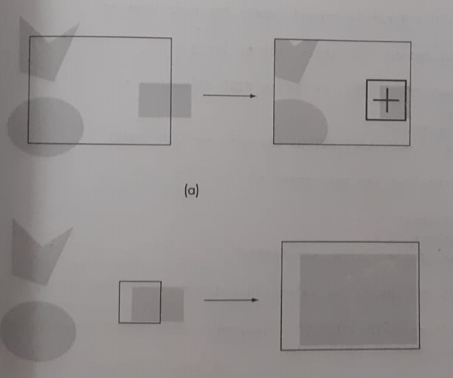

Slide 7
Design of Interactive Programs
The importance of these features and the difficulty of designing a good interactive program should never be underestimated.
Defining what characterizes a good interactive program is difficult, but recognizing and appreciating a good interactive program is easy. Such programs include features such as
A smooth display, showing neither flicker nor any artifacts of the refresh process
A variety of interactive devices on the display
A variety of methods for entering and displaying information
An easy-to-use interface that does not require substantial effort to learn
Feedback to the user
Tolerance for user errors
A design that incorporates consideration of both the visual and motor properties of the human

Slide 10
Curved Surfaces

Slide 11
Curved Surfaces
Equations for objects with curved boundaries can be expressed in either a parametric or a nonparametric form.
The various objects that are often useful in graphics applications include quadric surfaces, superquadrics, polynomial and exponential functions, and spline surfaces.
These input object descriptions typically are tessellated to produce polygon-mesh approximations for the surfaces.

Slide 12
Quadric Surfaces
A frequently used class of objects are the quadric surfaces, which are described with second-degree equations (quadratics).
They include spheres, ellipsoids, tori, paraboloids, and hyperboloids.
Quadric surfaces, particularly spheres and ellipsoids, are common elements of graphics scenes, and routines for generating these surfaces are often available in graphics packages.

Slide 13

Sphere
In Cartesian coordinates, a spherical surface with radius r centered on the coordinate origin is defined as the set of points (x, y, z) that satisfy the equation
the spherical surface in parametric form, using latitude and longitude angles

Slide 14


Slide 15
To generate a quadric surface using GLU functions
assign a name to the quadric,
activate the GLU quadric renderer, and
designate values for the surface parameters.
The following statements illustrate the basic sequence of calls for displaying a wire-frame sphere centered on the world-coordinate origin
GLUquadricObj *sphere1;
sphere1 = gluNewQuadric ( );
gluQuadricDrawStyle (sphere1, GLU_LINE);
gluSphere (sphere1, r, nLongitudes, nLatitudes);

Slide 16
Three steps to create a cylinder:
1. Create a GLU quadric object
GLUquadricObj *p = gluNewQuadric();
2. Set to wire frame mode
gluQuadricDrawStyle(GLU__LINE);
3. Derive a cylinder object from p
gluCylinder (quadricName, rBase, rTop, height, nLongitudes,
nLatitudes);

Slide 17
GLUT Quadric-Surface Functions
We generate a GLUT sphere with either of these two functions:
glutWireSphere (r, nLongitudes, nLatitudes);
glutSolidSphere (r, nLongitudes, nLatitudes);
where the sphere radius is determined by the double-precision floating-point number assigned to parameter r.
Parameters nLongitudes and nLatitudes are used to select the integer number of longitude and latitude lines that will be used to approximate the spherical surface as a quadrilateral mesh

Slide 18
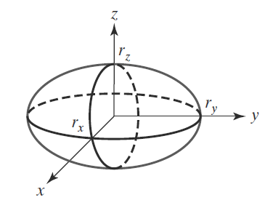
Ellipsoid
An ellipsoidal surface can be described as an extension of a spherical surface where the radii in three mutually perpendicular directions can have different values. The Cartesian representation for points over the surface of an ellipsoid centered on the origin is

Slide 19
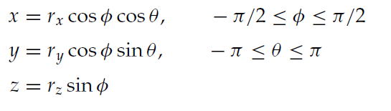
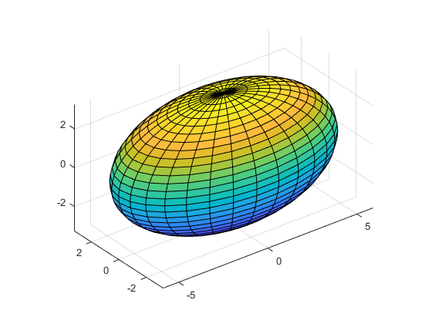
And a parametric representation for the ellipsoid in terms of the latitude angle φ and the longitude angle θ in Figure 2 is

Slide 20
Torus
A doughnut-shaped object is called a torus or anchor ring.
Most often it is described as the surface generated by rotating a circle or an ellipse about a coplanar axis line that is external to the conic.
The defining parameters for a torus are then the distance of the conic center from the rotation axis and the dimensions of the conic.
A torus generated by the rotation of a circle with radius r in the yz plane about the z axis is shown in Figure.

Slide 21
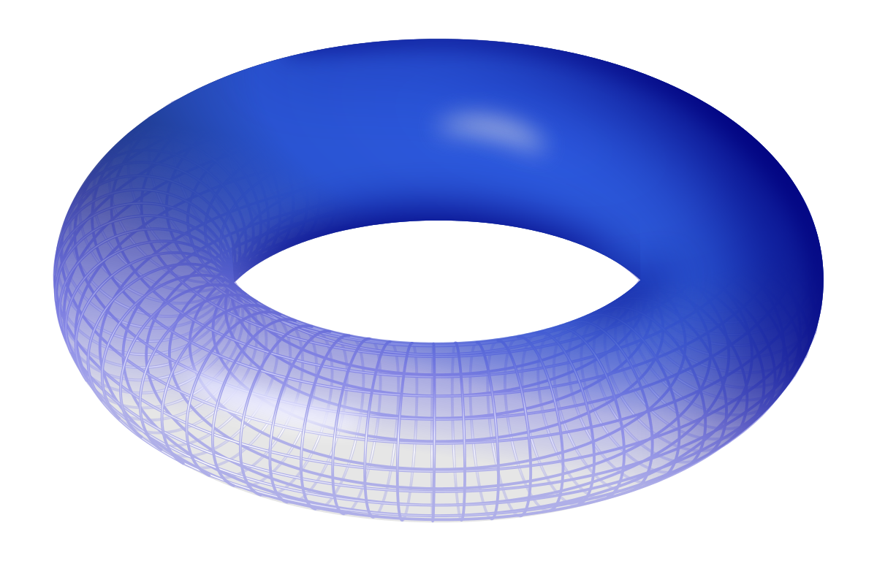

Slide 22
glutWireTorus (rCrossSection, rAxial, nConcentrics, nRadialSlices);
glutSolidTorus (rCrossSection, rAxial, nConcentrics, nRadialSlices);
The torus obtained with these GLUT routines can be described as the surface generated by rotating a circle with radius rCrossSection about the coplanar z axis, where the distance of the circle center from the z axis is rAxial
Parameter nConcentrics specifies the number of concentric circles (with center on the z axis) to be used on the torus surface
parameter nRadialSlices specifies the number of radial slices through the torus surface.

Slide 23
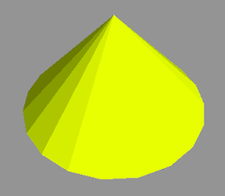
glutWireCone (rBase, height, nLongitudes, nLatitudes);
glutSolidCone (rBase, height, nLongitudes, nLatitudes);
We set double-precision, floating-point values for the radius of the cone base and for the cone height using parameters rbase and height, respectively.
parameters nLongitudes and nLatitudes are
assigned integer values that specify the number
of orthogonal surface lines for the quadrilateral
mesh approximation.

Slide 24
TeaPot
We can display the teapot, as a mesh of over 1,000 bicubic surface patches, using either of the following two GLUT functions:
glutWireTeapot (size);
glutSolidTeapot (size);
The teapot surface is generated using OpenGL B´ezier curve functions
Parameter size sets the double-precision floating-point value for the maximum radius of the teapot bowl. The teapot is centered on the world-coordinate origin coordinate origin with its vertical axis along the y axis.

Slide 25
